Slide 1

DEPARTMENT OF COMPUTER SCIENCE AND ENGINEERING
UNIVERSITY COLLEGE OF ENGINEERING
ADIKAVI NANNAYA UNIVERSITY
RAJAMAHENDRAVARAM
Driver Guidance System for Indian Roads
Under the esteemed guidance of
Mr. M. RamaKrishna
Assistant Professor
Department of CSE
Submitted by
N A V RAMA KRISHNA REDDY
IV B.Tech CSE
Reg No: 198297601035

Slide 2
CONTENTS
Abstract
Introduction
Literature Survey
Existing System
Drawbacks of Existing Systems
Proposed System
System Architecture
Requirements
Uml Diagrams

Slide 3
ABSTRACT
A driver guidance system is an advanced technology that assists drivers in navigating and maneuvering their vehicles on the road.
These systems typically use a combination of sensors, cameras, and GPS technology to provide real-time information to the driver about their surroundings, including traffic patterns, road conditions, and potential hazards.
The goal of a driver guidance system is to improve safety and increase efficiency on the road by providing drivers with the information they need to make informed decisions about their driving behavior.
The system can also provide information on the recommended speed and recommended path to take when approaching the obstacle, helping the driver to maintain control and avoid damage to the vehicle.

Slide 4
INTRODUCTION
It uses sensors, cameras, and algorithms to detect road conditions and hazards.
The system provides real-time guidance and suggestions to the driver.
It reduces the risk of accidents and makes driving more efficient and enjoyable.
It provides speed limit reminders, and obstacle avoidance, path prediction.
It also analyzes road conditions and traffic signals.
The goal of the system is to improve road safety and the driving experience.

Slide 5
LITERATURE SURVEY
Title | Author | Methodology | Limitations
[1] End to end learning for self-driving cars. | Bojarski, M., Del Testa, D., Dworakowski, D., Firner, B., Flepp, B., Goyal, P. & Jackel L.D | Image processing Algorithms like OpenCV using Raspberry Pi. | This paper only explains about theoritical approach but doesn’t help in real time implementation.
[2] Detection of potholes and speed breakers on road. | Youngtae Jo and Seungki Ryu | A unique pothole-detection algorithm embedded in a black-box camera. | It identifies the Patholes and speed breakers but not all the other obstacles on roads.
[3] Real-time object detection method based on imporved YOLOv4-tiny | Heltin Genitha C Rajaji P Rahul S | Fully Convolutional Network (FCN) and Yolo v4-tiny | This system only helps in detecting objects but new drivers don’t know the proper way to move by them and get damage to the chassis of the car.

Slide 6
Existing System
The existing systems of Driver Guidance System (DGS) in India include features such as anti-lock brakes, electronic stability control, lane departure warning, and forward collision warning.
These systems are mainly found in high-end vehicles and luxury cars.
The existing systems are designed to improve road safety and reduce the risk of accidents.
The existing systems are still limited in terms of their coverage and reach, as they are mainly available in premium cars.
The cost of the existing DGS systems is also a major challenge, as it is still unaffordable for most people in India.

Slide 7
Drawbacks of Existing Systems
The existing system of driver guidance systems in India has several drawbacks. Some of the main drawbacks are:
Limited Availability
High Cost
Lack of Standardization
Limited Awareness
Reliability Issues
Lack of proper maintenance
Limited Integration

Slide 8
Proposed System
The goal of this system is to guide the drivers and warn them about upcoming obstacles on Indian Roads and provide best instructions on how to handle them.
This can be divided into two main classes : Obstacle Detection and Guidance of Path.
The YOLO model can be trained using a dataset of images and annotations of obstacles commonly found on Indian roads, such as potholes, construction zones, and stray animals, to improve its accuracy in identifying these hazards for driver guidance systems.
A path prediction model for Indian roads, taking into account the unique characteristics of traffic and infrastructure, such as heavy congestion and potholes, can be developed to improve the efficiency and safety of navigation systems for drivers in India

Slide 9
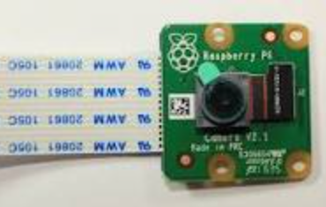
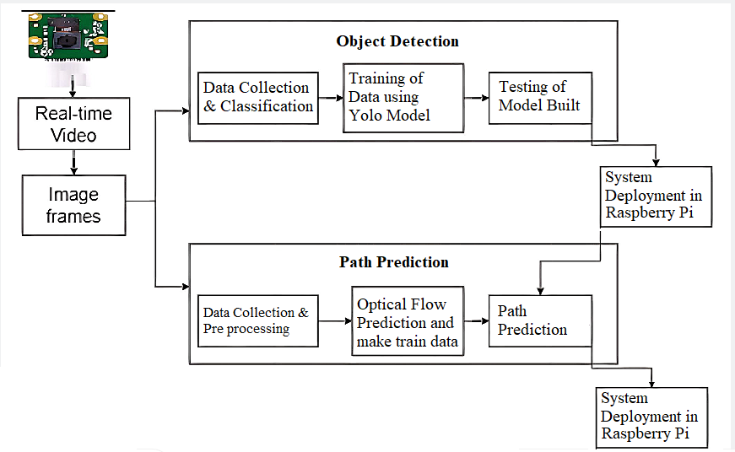
System Architecture
The architecture of the system
mainly consists of :
1. Object Detection
2. Path Prediction
3. Raspberry Pi

Slide 10
Hardware Requirements
 | In Development | In Production
Processor | Intel i3 or above | Raspberry Pi Model 4
RAM | Min 8 GB RAM | 8 GB RAM
Storage | 500 GB SSD | 16 GB SD Card
Camera | - | Pi Cam

Slide 11
Software Requirements
 | In Development | In Production
Operating System | Windows 10 or Ububtu | Raspberry Pi OS
Programming Language | Python | Python
IDE | Google Collaboratory | Geany/Thony Python
Libraries and Frameworks | Coco Dataset, MakeSense.ai, OpenCV | Numpy, matplotlib, OpenCV

Slide 12
Functional Requirements
Obstacle detection: Ability to detect and identify obstacles on the road, such as vehicles, pedestrians, animals, speed breakers and potholes.
Path prediction: Ability to predict the path of the vehicle and provide guidance to the driver on the best path to take.
User interface: The system should have a user-friendly interface for interaction and guidance to drivers.

Slide 13
Non-Functional Requirements
Reliability: The system must be reliable and provide consistent performance.
Accuracy: The system must accurately detect and identify obstacles on the road.
Responsiveness: The system must respond in real-time to changes in the road environment.
Usability: The system must be easy to use and understand for the driver.
Security: The system must be secure and prevent unauthorized access to sensitive data.
Scalability: The system must be scalable to accommodate future growth and changes in technology.
Maintainability: The system must be easily maintained and updated.

Slide 14
UML DIAGRAMS

Slide 15
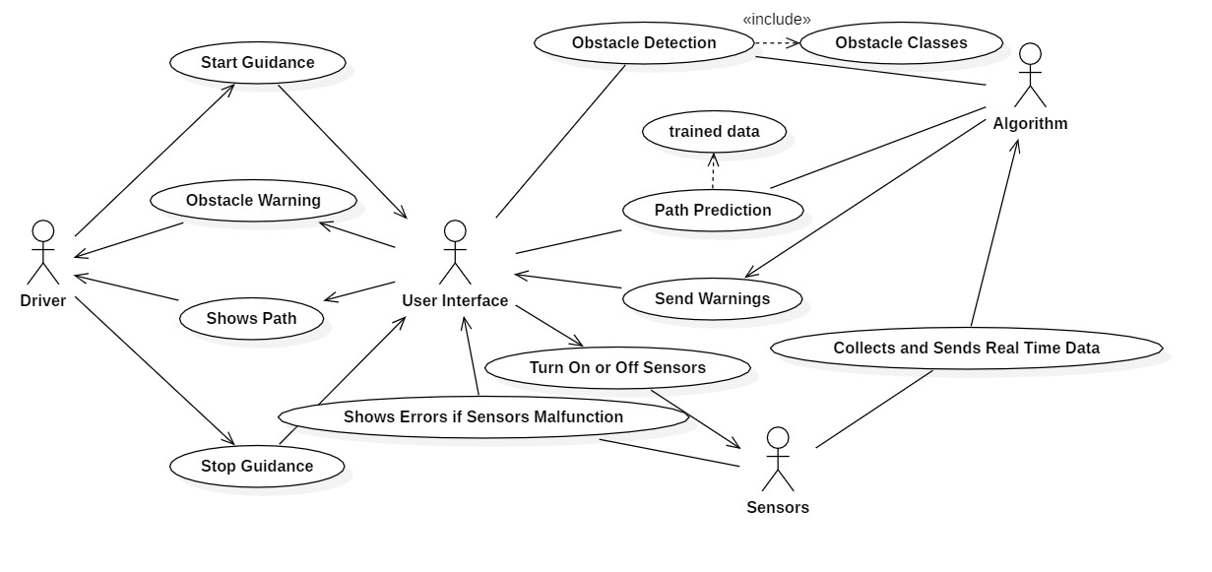
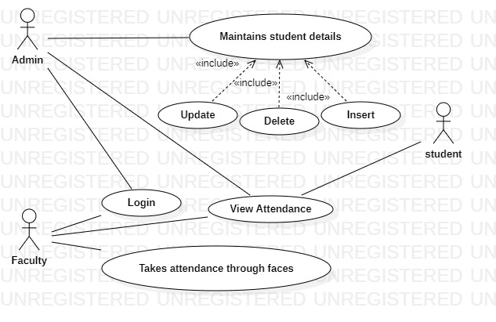
USECASE DIAGRAM
By using a Use Case Diagram, we can visualize the interactions between the actors and the system and understand how the system performs its tasks. This helps in the design and implementation of a more effective and efficient Driver Guidance System.

Slide 16
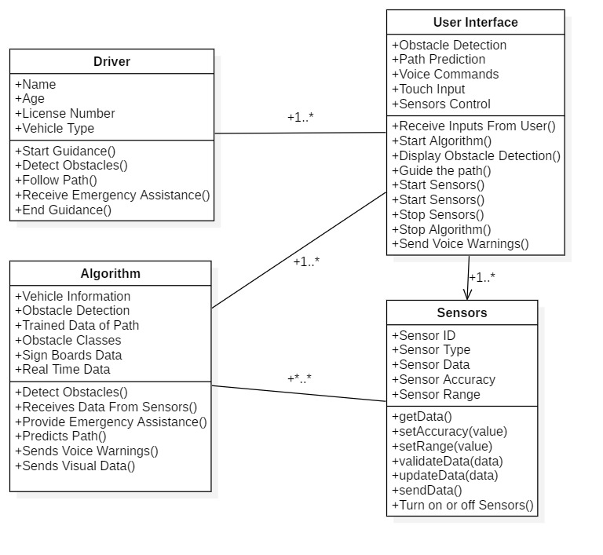
CLASS DIAGRAM
By using a Class Diagram, we can model the components of the system, their attributes, and their interactions. This helps in the design and implementation of a more structured and organized Driver Guidance System.

Slide 17
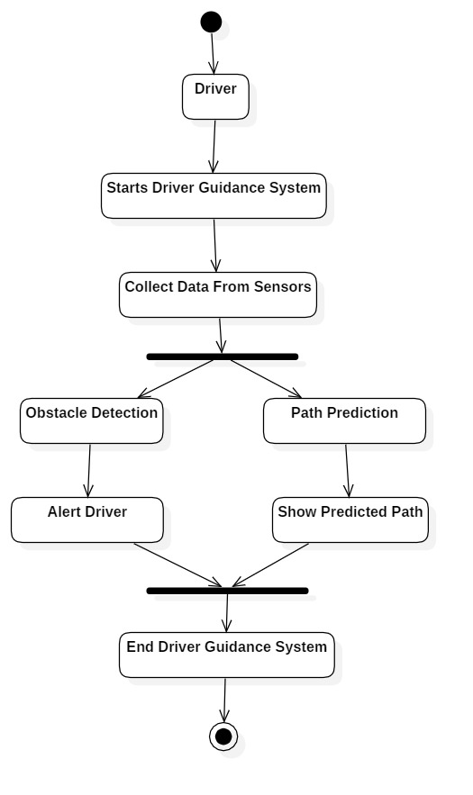
ACTIVITY DIAGRAM
The Activity Diagram provides a visual representation of the flow of activities involved in the DGS system, helping to understand the functioning of the system in a clear and concise manner.

Slide 18
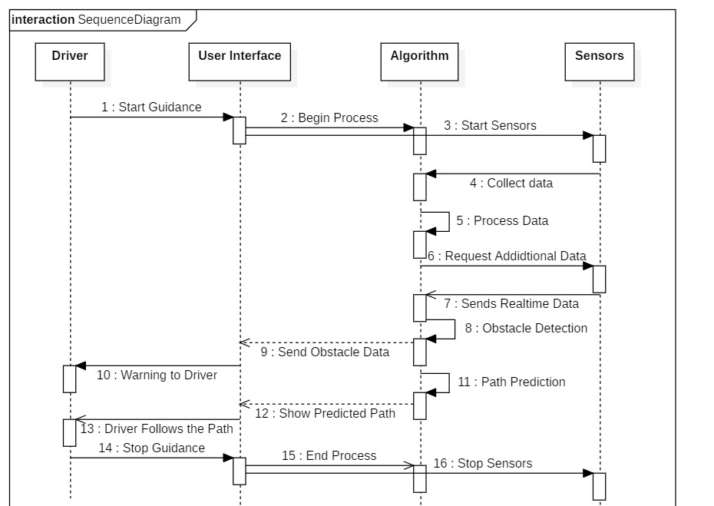
SEQUENCE DIAGRAM
By using a sequence diagram, we can model the interactions and communications between the components of the system. This helps in the design and implementation of a more organized and structured Driver Guidance System, and also provides an understanding of the flow of events in the system.

Slide 19
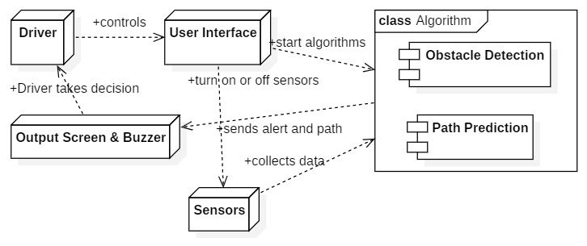
DEPLOYMENT DIAGRAM
By using a deployment diagram, we can visualize the physical deployment of the system components and their relationships. It provides a clear understanding of how the components are deployed, how they communicate, and the hardware required for deployment. This information is crucial for planning, implementing, and maintaining the Driver Guidance System.

Slide 20
IMPLEMENTATION
For Path Prediction:-
Dataset is taken from Kaggle user Anand P V , where they provide the driving data of
Indian Roads for 16.5min.
Size: 16.5 minutes = 16.5{min} x 60{1 min = 60 sec} x 30{fps} = 29,700 images ~ 2 GB.
It consists of real time images of the driving front angles through camera, steering angles
and other parameters of car functioning.
The dataset is already preprocessed and we need only steering angles data to build our model.

Slide 21
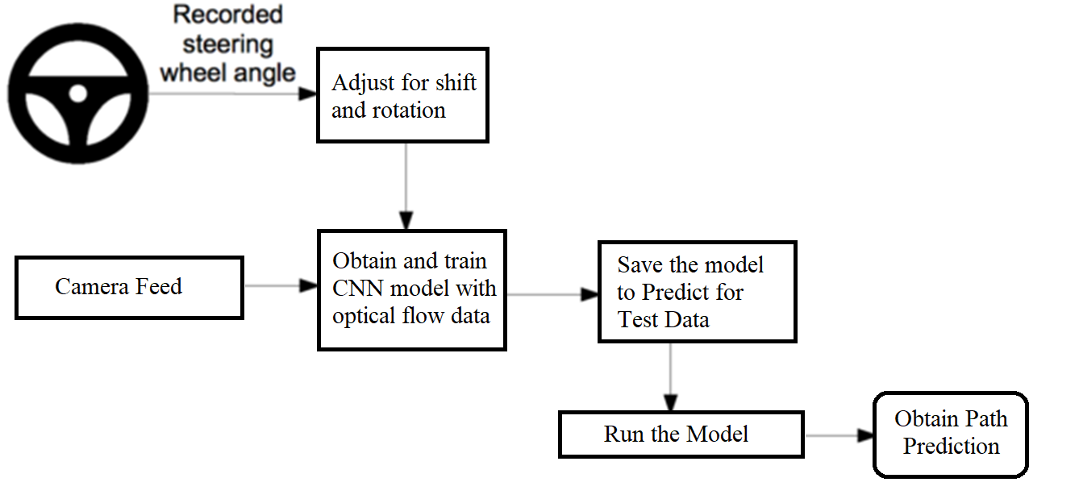
WORK FLOW DESIGN OF PATH PREDICTION:

Slide 22
WORK FLOW DESIGN OF OBJECT DETECTION:

Slide 23
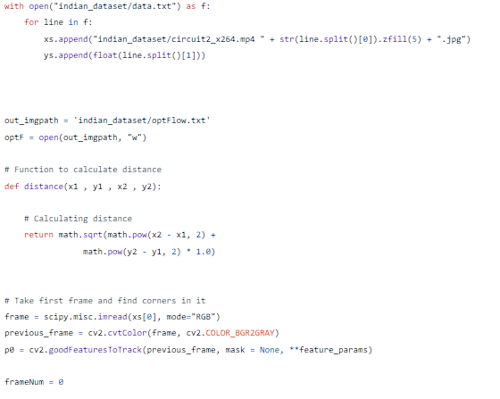
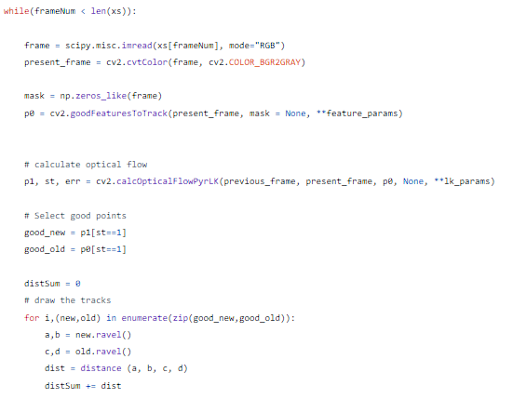
Generate Optical Flow Train Data:-
Below python program analyze recorded video & compute the optical flow parameter, ‘gamma’ across each adjacent frame in video and output to file.

Slide 24
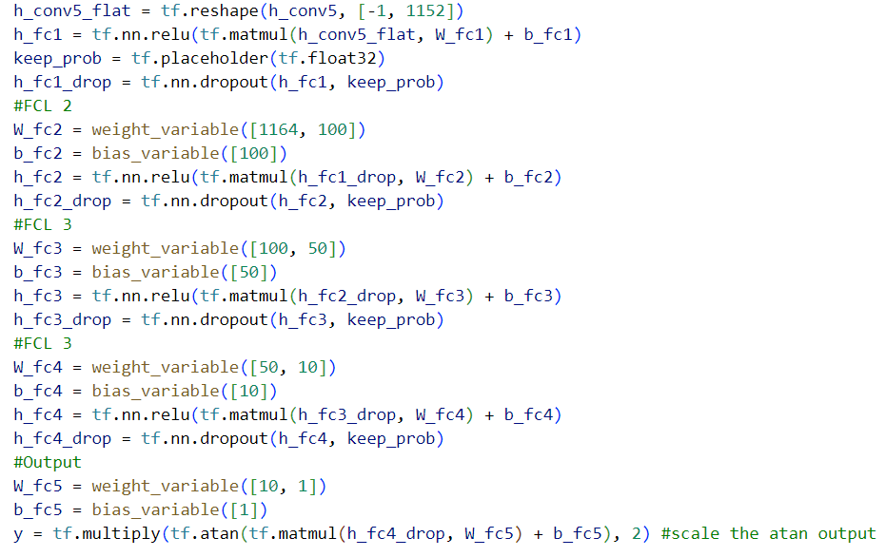
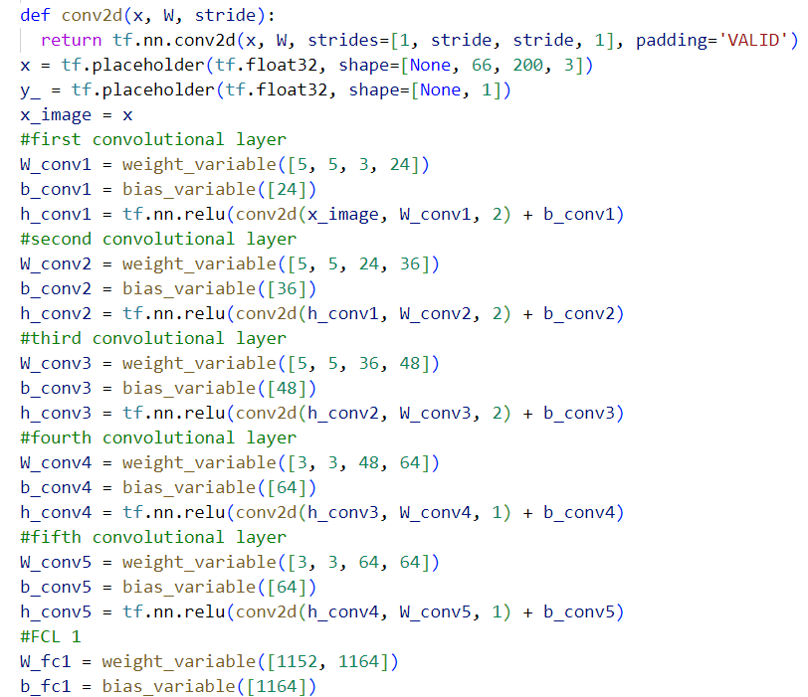
CNN model creation:-

Slide 25
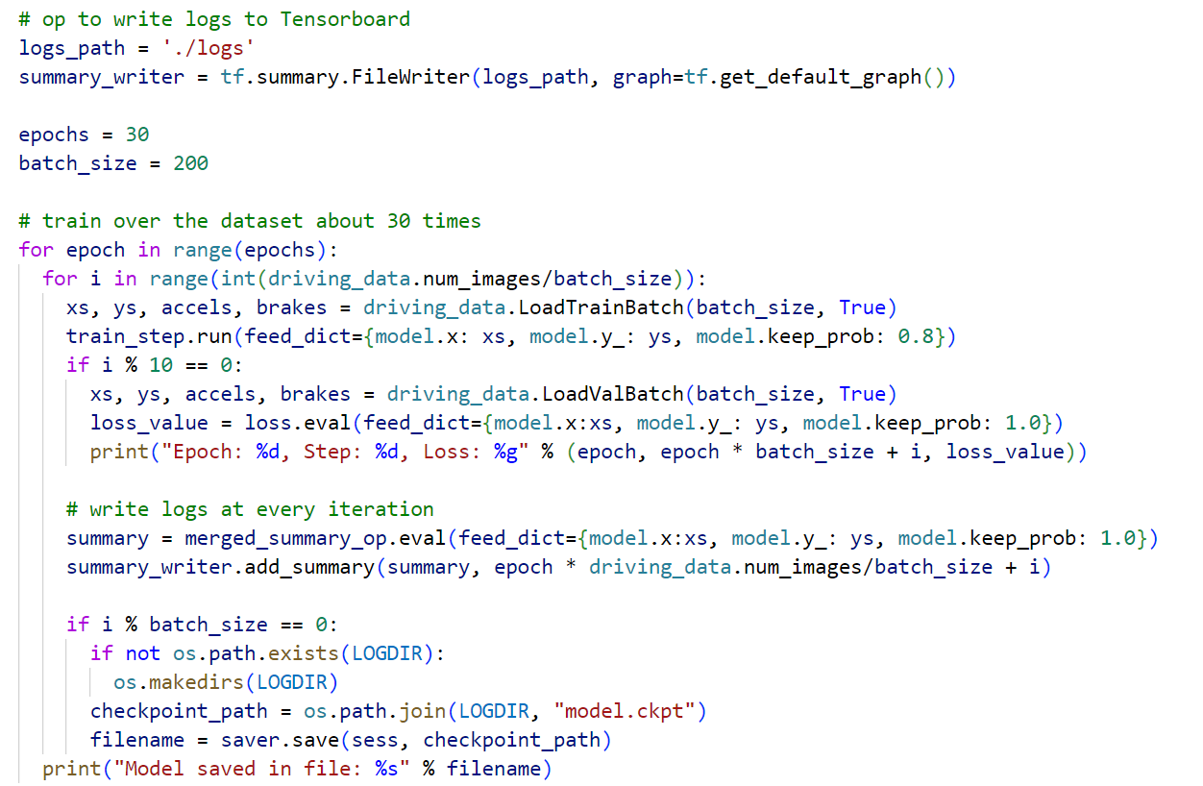
Training of Steering Prediction Model :-

Slide 26
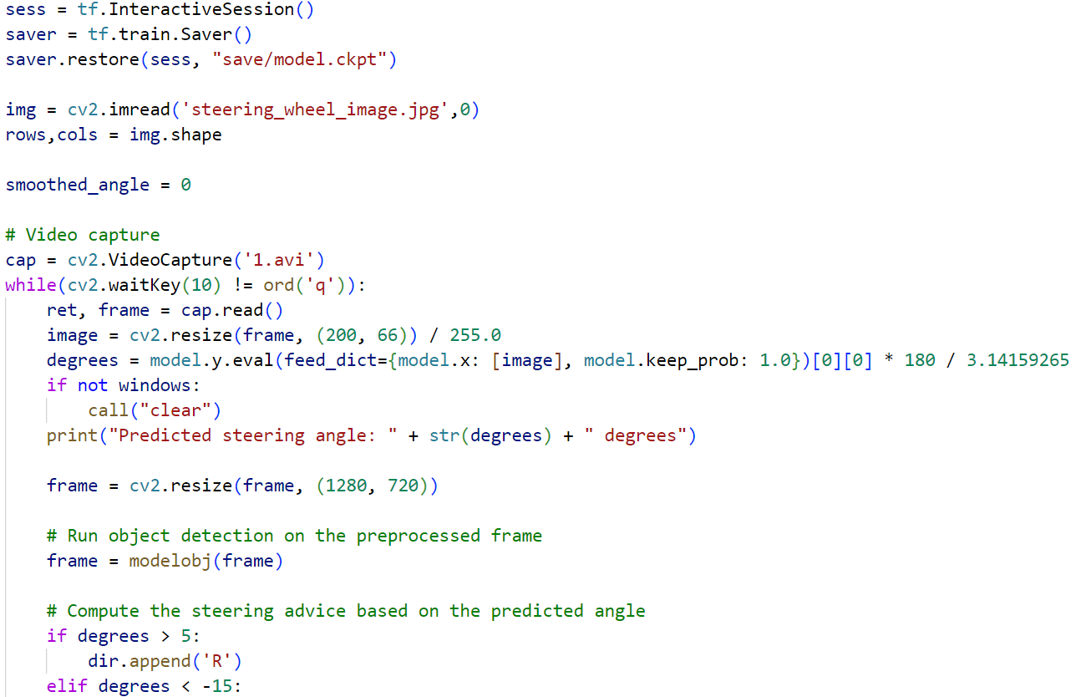
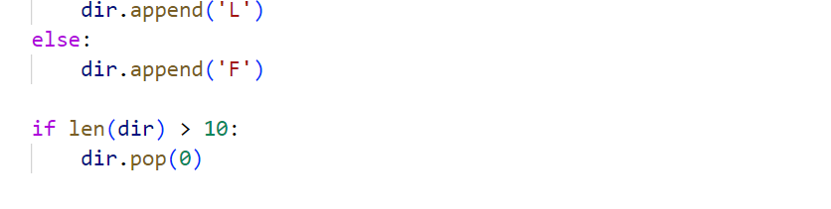
Running Trained Model for Path Prediction :-

Slide 27
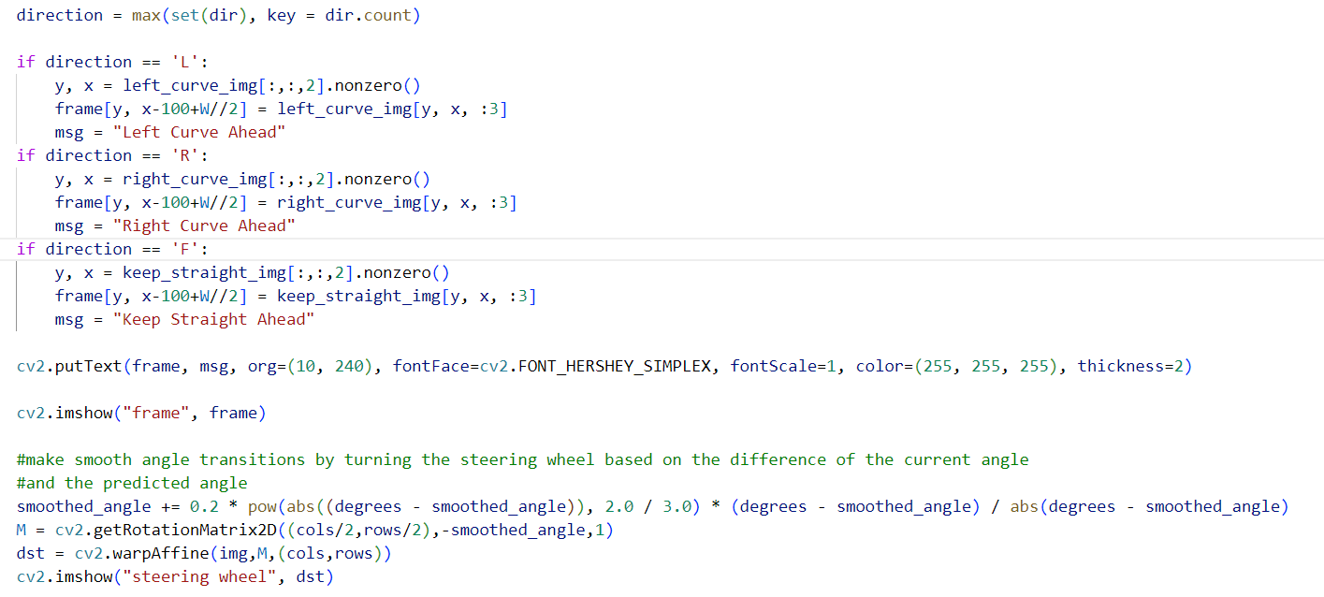
Writing Predicted Data to the frames :-

Slide 28
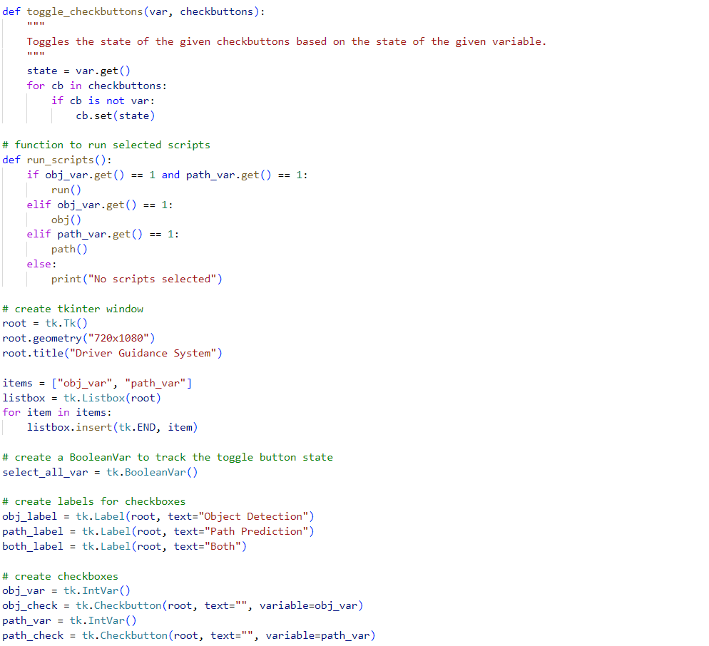
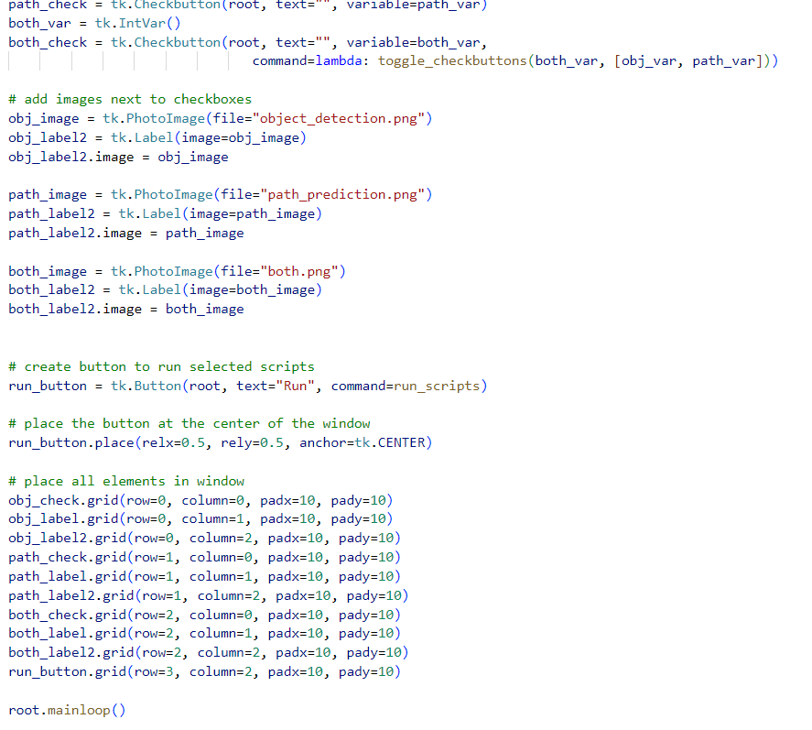
Tkinter User Interface for controlling the model:-

Slide 29
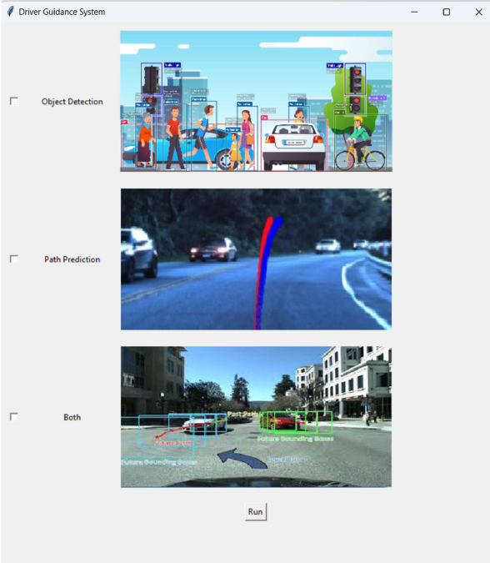
Output for User Interface with TKinter:-

Slide 30
Output for only Object Detection Model:-

Slide 31
Output for only Path Predicting Model :-

Slide 32
Output for Path Predicting Model Along with Object Detection :-

Slide 33
Output for both the models in RPi :-

Slide 34
CONCLUSION
I used the Tkinter library to create a GUI for the system interface that displays the settings for configuration of Guidance System to run both the model or run only either of the two models.
I have tested the system on both a laptop and a Raspberry Pi. We observed a significant decrease in performance on the Raspberry Pi compared to the laptop. The Object Detection model achieved a frame rate of 3 fps on the Raspberry Pi, and the Path Prediction model achieved a frame rate of 6 fps and both the models combined gives a frame rate of 2 fps.
In conclusion, the Driver Guidance System developed can provide valuable assistance to drivers and help them avoid accidents. However, further optimization is required to make the system more efficient, especially when deploying it on low-power devices like the Raspberry

Slide 35
FUTURE SCOPE
Improve the real-time performance of the system by using a more powerful processor or implementing the system on cloud infrastructure.
Expand the system's functionality to include lane detection and tracking to help drivers stay in their lane and avoid collisions with other vehicles.
Implement the system in autonomous vehicles to improve their safety and reliability.
Improve the accuracy of the object detection and path prediction models by training them on larger datasets and fine-tuning their parameters.
Test the system on different driving conditions and scenarios to evaluate its performance and reliability.

Slide 36
REFERENCES
[1] Bojarski, M., Del Testa, D., Dworakowski, D., Firner, B., Flepp, B., Goyal, P., Jackel, L. D., Monfort, M., Muller, U., Zhang, J., Zhang, X., Zhao, J., & Zieba, K. (2016). End to end learning for self-driving cars. arXiv preprint arXiv:1604.07316.
[2] Singh, G., Kumar, R., & Kashtriya, P. (2018). Detection of potholes and speed breaker on road. 2018 First International Conference on Secure Cyber Computing and Communication (ICSCCC), 490-495.
[3] Li, M., & Zhou, H. (2021). Real-time object detection method based on improved YOLOv4-tiny. IOP Conference Series: Earth and Environmental Science, 744(1), 012135.

Slide 37
THANK YOU

